Slide 1
Measuring spatial-temporal change of physical conditions in neighborhoods with street view imagery
Daniel Chen, Tingyan Deng, Evelyn Fitzgerald, Lijing Wang
2021 Data Science for Social Good summer program
Stanford University
Notes:
Good morning everyone, welcome to our presentation. We are the second team of the 2021 DSSG program and. Today, we will be talking about our project on measuring spatial-temporal change of physical conditions in neighborhoods with street view imagery. Spatial means across cities and temporal means across time.
basically the project is about measuring the change of physical conditions of buildings at different neighborhoods at different year and across different cities.

Slide 2





Our team
Daniel Chen
DSSG fellow
MS student
Stanford University
Tingyan Deng
DSSG fellow
Undergraduate student
Vanderbilt University
Evelyn Fitzgerald
DSSG fellow
MEng recent graduate
Cornell University
Lijing Wang
Technical mentor
PhD student
Stanford University
Jackie Hwang
Faculty mentor
Professor in Sociology
Stanford University
Notes:
First, let me introduce our amazing team. We have three student fellows: Daniel, me and Evelyn. Daniel just graduated from Stanford undergraduate studies and is returning for the master of statistics program. I am Tingyan. I am a rising senior student at Vanderbilt University study computer science, math, and economics. Evelyn just graduate from Cornell University With a Master of Computer Science. Our technical mentor is Lijing, she is a fourth-year PhD student at department of geological science at Stanford and Our faculty mentor is Dr. Hwang, she is a professor in sociology department at Stanford.

Slide 3
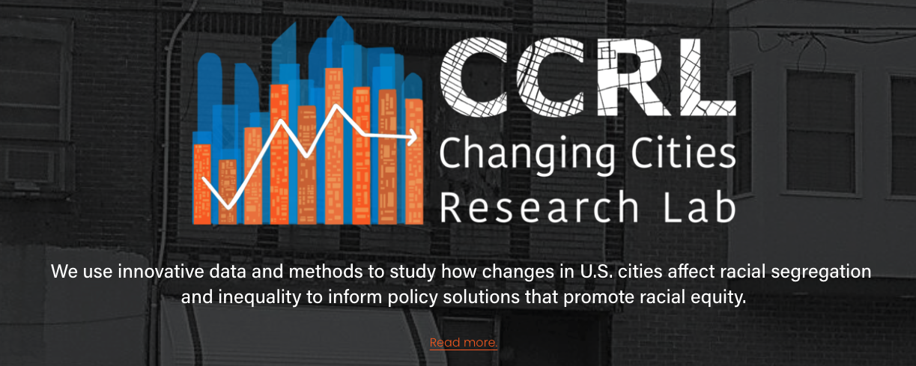
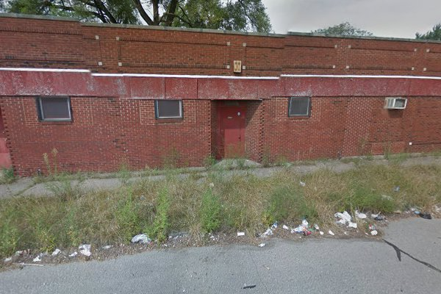
Project Motivation
Presence of
physical disorder
poorly maintained properties
vacant lots in neighborhoods
Well-being:
physical and mental health
crime and disorder
neighborhood disinvestment
Negatively affect
Neighborhood environmental characteristics
Notes:
Now let’s talk about the motivation behind our project. Previous research shows that the presence of physical disorder, poorly maintained properties, and vacant lots in neighborhoods can negatively affect neighborhood physical and mental health, it can also attract more crime and disorder. This would leads to neighborhood disinvestment. In addition, many studies related to residential well-being has shown that the greener the urban land, the happier the residents.
Clearly, neighborhood environments play a significant role in shaping the wellbeing of individuals and communities, which consequently contributing to inequality in the U.S. considering some of the negative effects mentioned before.
However, very few studies have investigated this process because collecting data on the physical conditions of neighborhoods, especially across neighborhoods and cities and over time, requires extensive time and labor costs.
Therefore, to address this challenge and also contribute to the current understanding of the potential effect of the neighborhood environment, we collaborate with Changing Cities Research Lab at Stanford University to identify the physical conditions of neighborhood environments at a larger-scale. But how exactly do we make our measurements into a larger-scale? How do we use any modern technology to get the street images across multiple years?
The greener, the happier? The effect of urban land use on residential well-being:
https://reader.elsevier.com/reader/sd/pii/S092180091500436X?token=00636251DC6D84FA7F64F41DB5AEF1706C097DD9316061FF81F219053708DDB3F51C40A1549B354E1B68D5DE5A3D7BB4&originRegion=us-east-1&originCreation=20210809173333
Effects of greening and community reuse of vacant lots on crime:
https://journals.sagepub.com/doi/full/10.1177/0042098015608058

Slide 4


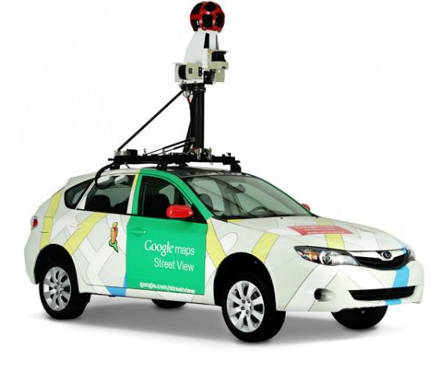
Evolution of systematic social observation (SSO)
Systematic social observation (SSO) at scale
Notes:
The approach to directly observe the physical, social, and economic characteristics of neighborhoods is called Systematic Social Observation (SSO)
When the idea of SSO first came around the 20th century, social scientists using SSO relied on street audits, where observers walked around and filled out a survey instrument
Then, In the 1990s, a research team, led by Robert Sampson used camcorder to record blocks and have coders filled out surveys after, which reduced time and labor costs from fielding survey takers
* Finally, in 2009, the Google street view imagery was released. They collected Street View imagery by driving, pedaling, and walking around and capturing imagery with special cameras. The camera was able to simultaneously collect images in multiple directions. GSV was publicly released in the US, which further reduced costs by providing recorded streets imagery and across multiple cities over years. And this is also how we got our images.

Slide 5
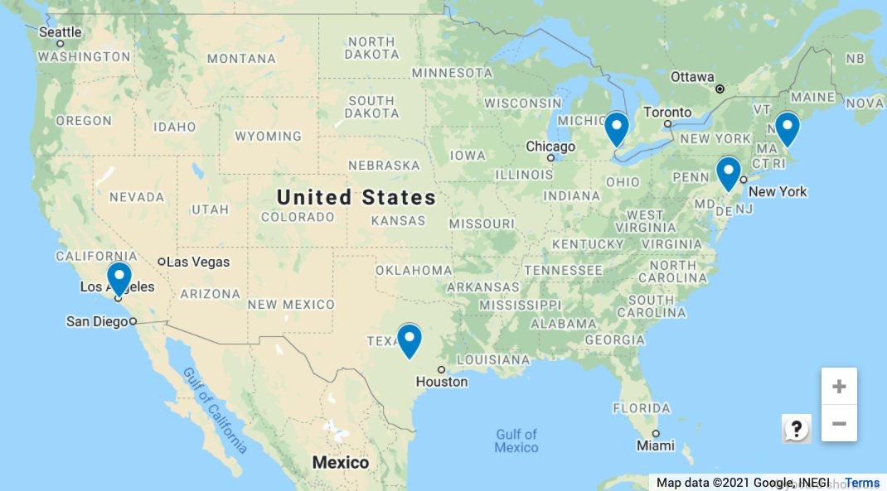
Project Goal
Utilizing deep learning to identify building upkeep from Google Street View images of urban streetscapes:
at a large scale
over time (2007–2017)
across multiple cities (Detroit, Boston, LA, etc.)
and quantitatively analyze relationship between building upkeep conditions and well-being characteristics
Notes:
So with the images obtained from GSV, our team aims to improve understanding of the role of physical and environmental neighborhood conditions in structuring inequality in wellbeing in U.S. cities. By doing so, this project aims to inform solutions that can improve the wellbeing of residents and reduce inequities.
Our project goal would be to using a deep learning approach, to visually identify upkeep/blight, building materials, and greenery layout around buildings from google street view images. Furthermore, we will use crowdsourcing and computer vision techniques to quantitatively measure physical aspects of urban neighborhood environments that have been linked to well-being in the last 10 years. Our analysis also across multiple cities including Detroit, Boston, LA, etc.. We link these measures with existing data on individual and community wellbeing to analyze how the physical and environmental conditions of neighborhoods affect the wellbeing of individuals and neighborhoods over time.

Slide 6
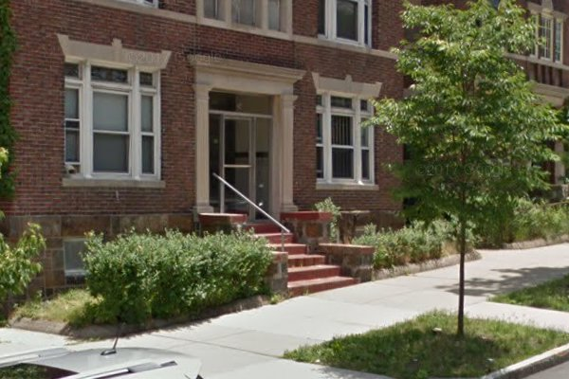
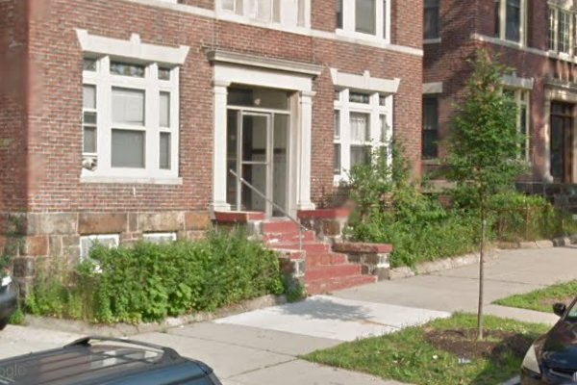
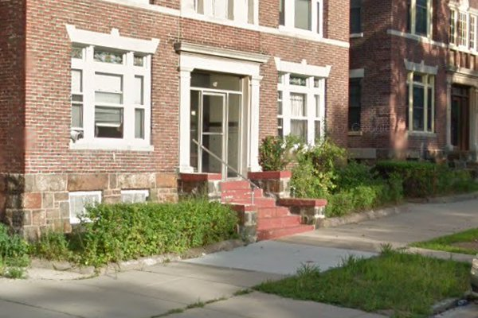
Google Street View images over time
2007 2014 2017
Notes:
To get a taste of what the Google street view images look like, here is one example of a building in detroit from 2007 to 2017.
With GSV, we are able to navigate a single location going back to 2007, and obtain images of the same building every 1-3 years.
As of 2017, GSV covers 10 million miles of images in 83 countries, this allowed us to navigate the street view over 10 years and understand the physical condition in different neighborhoods

Slide 7
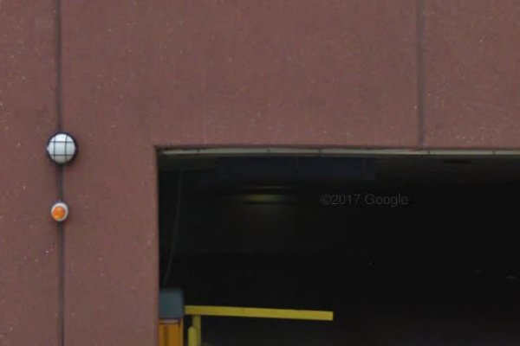
Training data collection
[Input] Street View Imagery
[Output] MTurk survey to generate TrueSkill scores
Training set: 2964 Boston images, 3995 Detroit images
Left
Right
Notes:
Now we have seen an example of the GSV image, let’s delve into the label data. So Our datasource is mainly the images scraped from Google Street View spanning from 2007-2017, with the images taken every 1-3 years and 15 million images in total. Our Lab has collected and preprocessed these data. Then, to create training data, we used a crowdsourcing platform, Amazon MTurk.
We basically use it as a survey and hire MTurkers to generate our training set.
The two images shown below is an example of our second stage survey
MTurkers were asked to compare the two images and answer which one has better upkeep
We used this method because we found that pairwise surveys have more reliability in producing comparisons across a set of objects
To make our training data more comprehensive and robust, each image is compared at least 18 times to produce stable estimates
And with AMT, we can capture tens of thousands of comparisons in a single day
Eventually, our training set consist of around 3 thousand images from Boston, and 4 thousand images from Detroit.

Slide 8
Image class labels
Compare pairs of images for better upkeep
Use comparisons to make TrueSkill score
Qualitatively create cutoffs on TrueSkill score to create 4 classes
Predict 4 classes
[Output] both class label and TrueSkill score:
Lower trueskill scores, higher classes, better building upkeep
Notes:
So After we receive the comparison of the images, we apply the trueskill score algorithm to rank them and apply a threshold to them to basically classify each image into a class. We have four classes in total, class 0, class 1, class 2 and class 3.
Now, you might have noticed that our images have both a TrueSkill score (which is a continuous label) along with a discrete class. And the reason why this was the case is because originally, our problem was set up as a classification task, and we were asked to predict different levels of upkeep ranging from 4 different classes.
And the way that these classes were derived is illustrated here on the slide. We basically generate the score from the comparison results done by MTurkerrs
Then that TrueSkill score was qualitatively analyzed, to create various cutoffs to create 4 different classes, and then the model was trained to predict those 4 classes.
Now, what we were thinking is that maybe it might make more sense to instead stop at step 2, and have the model instead directly predict the TrueSkill score. So in that case, we would be shifting the problem to a regression task.
And the main reason why we felt this might make sense is because of the interpretability of the classes.
Also we realized that the higher the class number, the better the building upkeep and the lower the trueskill score. Now let’s look at some of the example images to better understand what I meant.

Slide 9
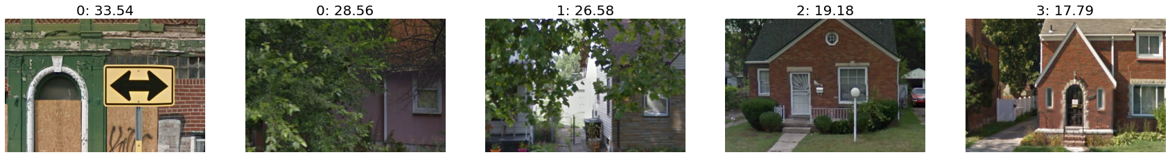
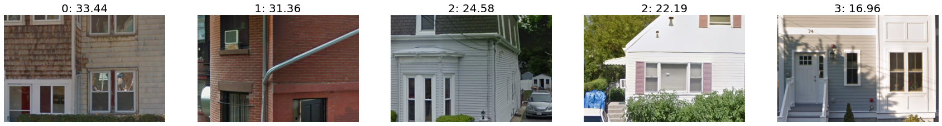
Building upkeep condition and TrueSkill scores
Detroit
Lower trueskill scores, higher classes, better building upkeep
Boston
Notes:
Here is an example of some output trueskill scores and classes. The top row is the detroit image and bottom row is the Boston image. Let’s take the first image as an example, the first number 0 is the trueskill class. The second number 33.54 is the trueskill score. so as you can see we have all four classes (0-3) in this screenshot and you might realized that as we go from left to right, the lower the trueskill score, the higher the class number and the higher the upkeep. As a visual inspection, Boston tend to have a better upkeep compared to Detroit as you can tell from the first three images. To further analyze this possibility, we generated bar chart to visualize the percentage of different classes for the two cities.

Slide 10
Building upkeep condition and TrueSkill scores
Detroit
Boston
Notes:
Here is an example of some output trueskill scores and classes. The top row is the detroit image and bottom row is the Boston image. Let’s take the first image as an example, the first number 0 is the trueskill class. The second number 33.54 is the trueskill score. so as you can see we have all four classes (0-3) in this screenshot and you might realized that as we go from left to right, the lower the trueskill score, the higher the class number and the higher the upkeep. As a visual inspection, Boston tend to have a better upkeep compared to Detroit as you can tell from the first three images. To further analyze this possibility, we generated bar chart to visualize the percentage of different classes for the two cities.

Slide 11
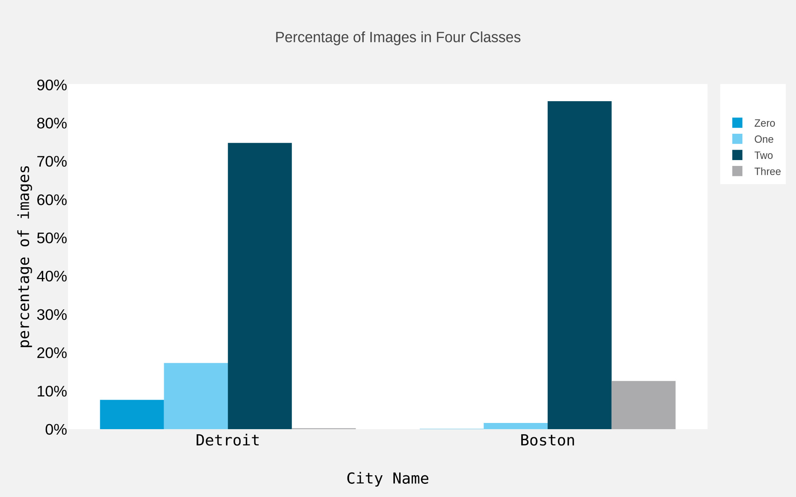
Class imbalance
Notes:
Here is a bar chart that visualize the percentage of classes for the two cities. The x-axis is the name of the city, Detroit and Boston. The y axis is the percentage of images that belongs to a certain class. We noticed a problem of class imbalance and we can clearly see Boston has a better upkeep because we have much more Class 2 and Class 3 in Boston. Detroit has 7.6 percentage of class 0 images while Boston only has 0.0675 percent. Also, Boston has a 12.6% class 3 images but Detroit only has 0.25%.
Now I will pass to Daniel.

Slide 12
Final training data
2964 Boston images, 3995 Detroit images
Each image has:
Discrete class (0, 1, 2, or 3)
TrueSkill score
Notes:
Daniel: So as a recap of what our training data looks like, we have around 3000 Boston images and around 4000 Detroit images that we’re going to be training on. And each image has a discrete class (from 0, 1, 2, or 3), and it also has a TrueSkill score.

Slide 13
Challenges in building the model
Regression vs Classification problem
How to align TrueSkill scores across Boston and Detroit?
Notes:
Daniel: So using this data, we want to be able to train a model that predicts building upkeep.
But there were two main challenges we had when we were trying to build the model.
The first was deciding whether to pose the problem as a classification or regression task
And the second challenge was getting the TrueSkill scores aligned across cities.
~0:20

Slide 14
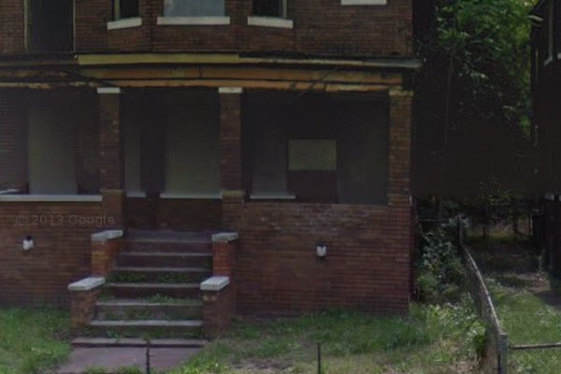
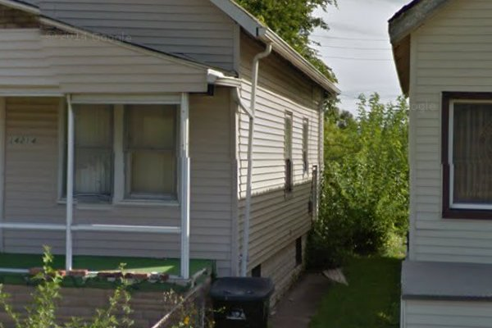
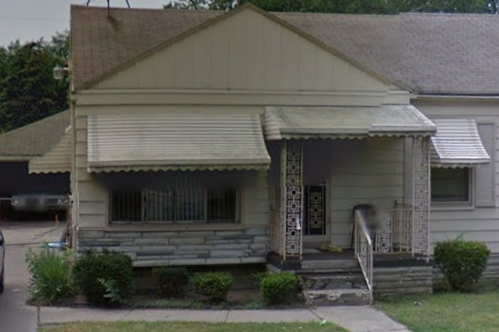
Challenge: classification vs regression
Originally, predict discrete upkeep classes
are these classes interpretable?
class 0 class 1 class 2
Notes:
Daniel: So as you may have noticed, our images have both a TrueSkill score (which is a continuous label) along with a discrete class label. And the reason why this was the case is because in previous research from our lab, we were looking at levels of *trash* in urban environments, and we were measuring trash using different classes, such as no trash, a little bit of trash, a lot of trash, etc. And so when we first started off trying to detect building upkeep, we used a similar method where we were trying to predict discrete classes of building upkeep. But what we felt is that once we switched our task from identifying *trash* to identifying *upkeep*, using *classes* to describe upkeep wasn’t as easy to interpret as before.
So as an example, here we have images from 3 of the classes. Now if I removed these labels and I asked you to look and tell me which class each of these images belong to, it might be really hard for you to figure out. You might be able to tell me which image might look better than the other, but it’s not super clear that they’re so different that they belong in different classes.
And so what we decided is that instead of predicting these discrete classes, we would instead directly predict this continuous TrueSkill score. And so because of that, we shifted our problem from a classification task to a regression task. So that was our first challenge.
~1:15

Slide 15
Challenge: scores across multiple cities
TrueSkill scores derived from image comparisons
Comparisons are done within each city
TrueSkill score on different scale for each city
25 in Detroit ≠ 25 in Boston
In order to train model with both cities:
Need to have all TrueSkill scores at same scale
Notes:
Daniel: Our second challenge actually came from the fact that we were using this TrueSkill scored as our label.
So one important thing to note about these TrueSkill scores is that the Boston data and the Detroit data aren’t on the same scale. The reason why this is the case is because (as we mentioned earlier), TrueSkill scores are derived by comparing pairs of images to see their upkeep.
But these comparisons are only done *within* each city, so images from Boston are never actually directly compared to images from Detroit. And that means that when we get the TrueSkill scores, a label of 25 in *Detroit* might not reflect same upkeep as a label of 25 in *Boston*.
And this is an issue, because if they’re not on the same scale, then we can’t use the data from both cities to train the model.
So because of this, we needed to design a way so that the TrueSkill scores from Detroit line up with the TrueSkill scores from Boston
~1:00

Slide 16
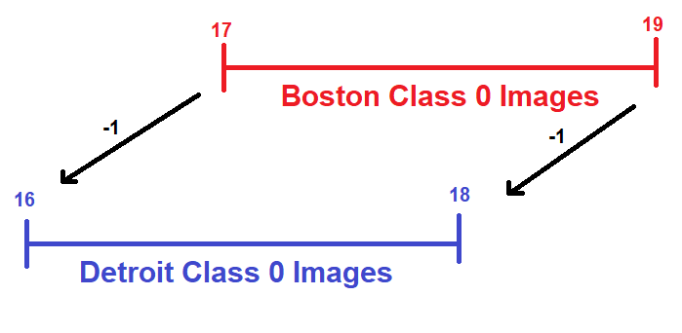
Score alignment solution
Important note: class labels qualitatively same across cities
Solution: transform TrueSkill scores by aligning boundary of classes
Using this method, piecewise linear transformation on TrueSkill
Notes:
Daniel: But one piece of information we can leverage is the fact that, while the *TrueSkill* scores aren’t comparable across cities, the class labels (of 0, 1, 2, and 3) *are* comparable across cities.
The reason why this is the case is because (as we mentioned earlier) the classes are derived by qualitatively thresholding the TrueSkill score. So because of that, these classes are explicitly designed so that they should reflect the same level of upkeep. So a class label of 0 in Boston, for instance, should reflect the same level of upkeep as class 0 in Detroit.
So using this information, we can align the TrueSkill scores by looking at the boundary TrueSkill scores of each class.
So let’s walk through an example.
Say we were looking at class 0 images from Boston. Let’s say that the range of TrueSkill scores for those images are from 17 to 19.
Now let’s look at the corresponding class 0 images from Detroit. Now in a perfect world, these class 0 images from Detroit would have the same range of TrueSkill scores that we saw in Boston. But we know that’s not the case yet since they’re not on the same scale. So let’s say, for instance, that the range for Detroit is 16 to 18.
Now what we’d like to see is for the range of TrueSkill scores in Boston to line up with what we see in Detroit. So what we can do is we can just move those scores over using a linear transformation. And so in this case if we wanted the range in Boston to line up with the range in Detroit, we can take all the class 0 images from Boston and just subtract one from their TrueSkill score. And by doing so, *all* the class 0 images from *both* cities would have a range from 16 to 18.
And then if we do this same process for class 1, and class 2, and class 3, we can essentially create a piecewise linear transformation to turn the scores from Boston onto the same scale as Detroit.
So now that we’ve figured out exactly *how* we want to use these images and their labels, we can now jump into the model that we built.
~2:00

Slide 17
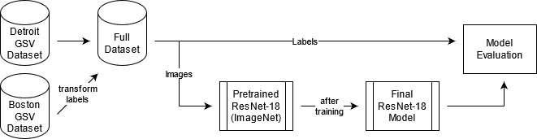
Model architecture
Notes:
Daniel: So for our model architecture, first we take our Boston dataset and align the TrueSkill score labels to our Detroit dataset.
Then, we use that combined dataset to finetune a ResNet18 model that has been pretrained on ImageNet.
And then, finally we get a model that we can feed new Google Street View images from a variety of cities, and we can get out a TrueSkill prediction that reflects the building upkeep.
~0:30

Slide 18
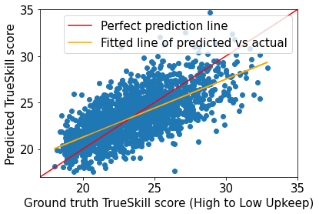
Result: regression and classification
R² = 0.484, MSE = 4.487
Notes:
Daniel: And using this model, here are the results of our validation set (which includes images from both Boston and Detroit).
So on the x-axis we have the actual score, and on the y axis we have the score that our model predicted. The red line represents a perfect model where ground truth and predicted score are exactly 1 to 1, and you can see that our model also follows that slope pretty closely.
And overall, this was our best performing model, and it had a R^2 of 0.484 and a MSE of 4.487.
~0:30

Slide 19
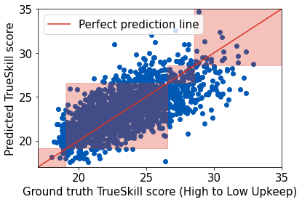
Result: regression and classification
R² = 0.484, MSE = 4.487
Notes:
Daniel: We were also curious about how this regression model would hold up if it were forced to predict classes instead.
And so to do this, we applied the cutoffs originally used to turn the TrueSkill scores into classes, except this time we directly applied those cutoffs to the predicted scores.
So if you look at the graph, there’s now these red squares that are overlaid, and these squares represent the regions where images have the correct classification result based on this thresholding.
So you can see that overall, it does pretty well in general, especially for the majority class, although it definitely still has some issues with some of the minority classes in the top right, since they have regions that are a lot smaller and therefore easier to misclassify.
~0:45

Slide 20
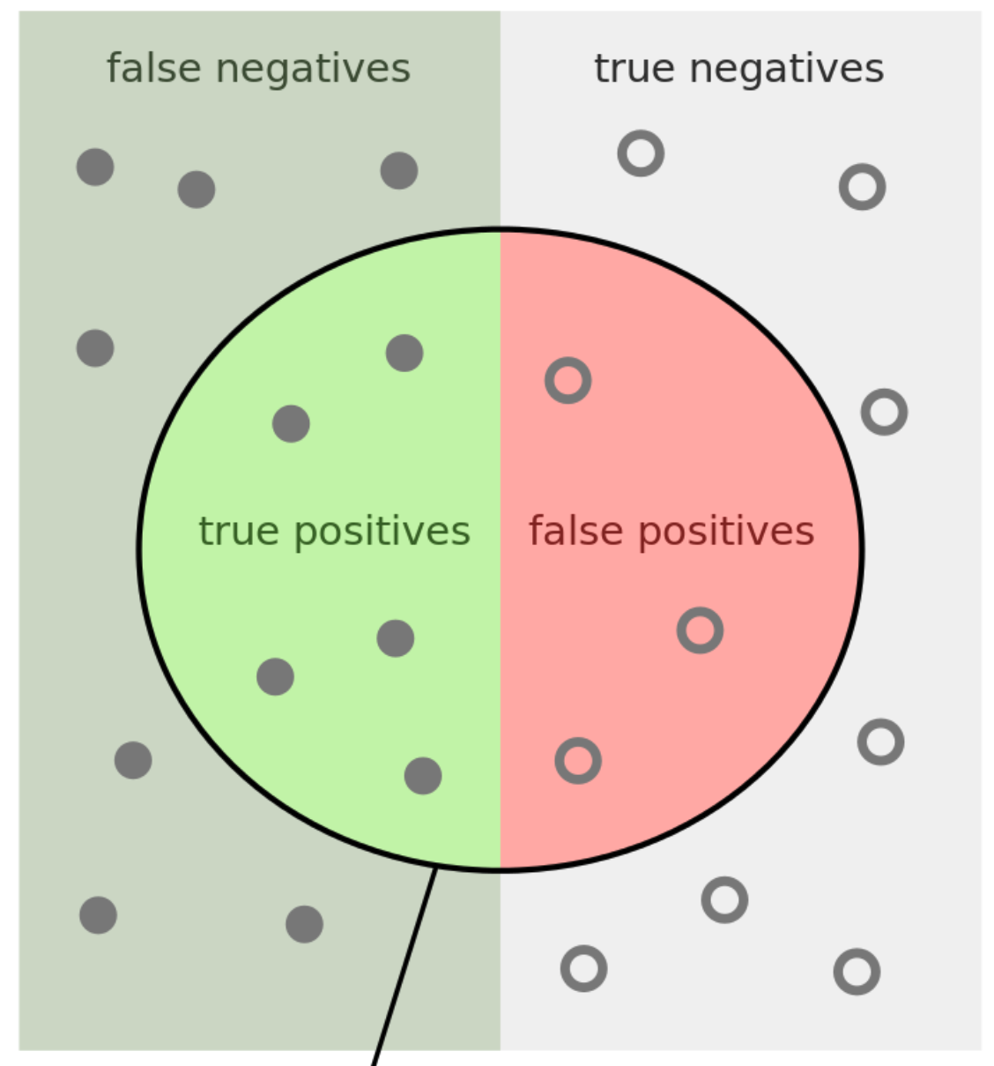
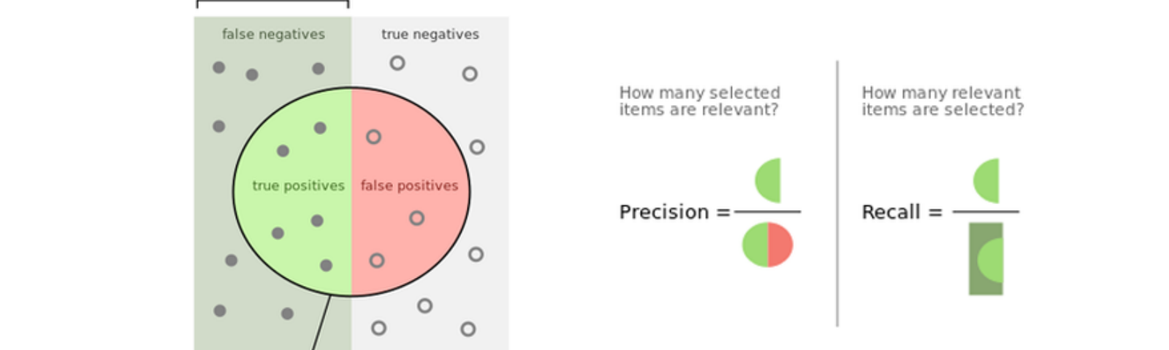
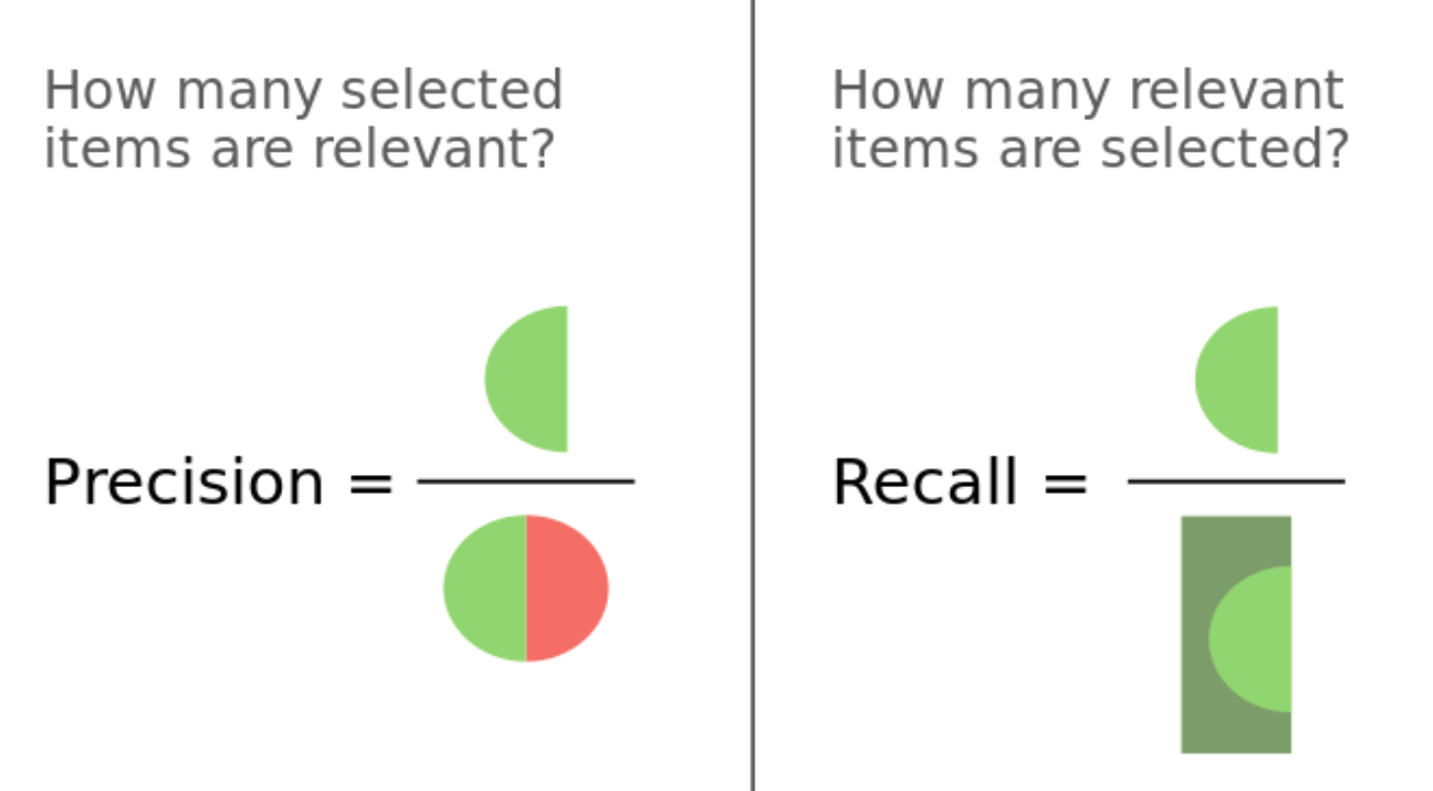
Result: comparing to naive model
How do these results compare to naive model?
Model that randomly predicts classes based on class frequency
Source: https://en.wikipedia.org/wiki/Precision_and_recall
Notes:
Daniel: So to see how this model was performing on these minority classes, we also compared our model to a naive baseline, where the naive classifier randomly predicts classes based on how often the class shows up in the dataset. So if the class shows up 70% of the time in the dataset, every time the classifier sees an image it’ll have a 70% chance of randomly picking that class.
And the metrics we used were the precision and recall.
And just as a mental refresher on these terms, the *precision* of a specific class (let’s call this class, class X)
The precision is the True Positives (so the number of class X images you correctly classify as class X) Divided by the total number of images that you *Predicted* as class X.
So the precision kind of measures, when you predict class X, is the image actually from class X.
Meanwhile the recall of a class is the True Positives divided by the number of images that have a ground truth label of class X.
So the recall kind of measures how much of the class X did you actually correctly classify.
~1:15

Slide 21
Result: comparing to naive model
Naive model Our model
class | precision | recall | N
0 | 0.05 | 0.05 | 86
1 | 0.09 | 0.09 | 164
2 | 0.81 | 0.81 | 1416
3 | 0.04 | 0.04 | 75
accuracy |  |  | 0.67
class | precision | recall | N
0 | 0.42 | 0.27 | 86
1 | 0.25 | 0.22 | 164
2 | 0.86 | 0.90 | 1416
3 | 0.22 | 0.16 | 75
accuracy |  |  | 0.77
Notes:
Daniel: And so you can see that for the minority classes, which are class 0, 1, and 3, while the naive model only has a precision and recall below 0.1, our model does significantly better in both the precision and recall for those classes. And so it suggests that while our model isn’t perfect at predicting these minority classes, it’s definitely doing a lot better than chance.
~0:30

Slide 22
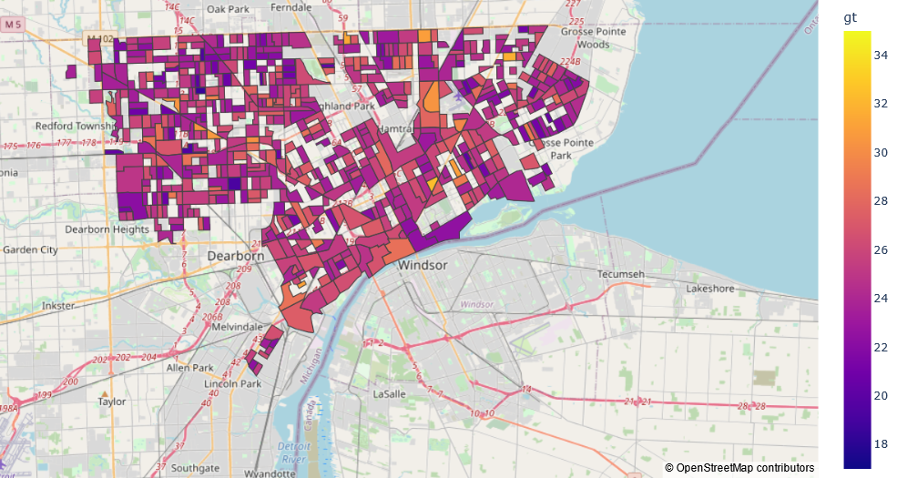
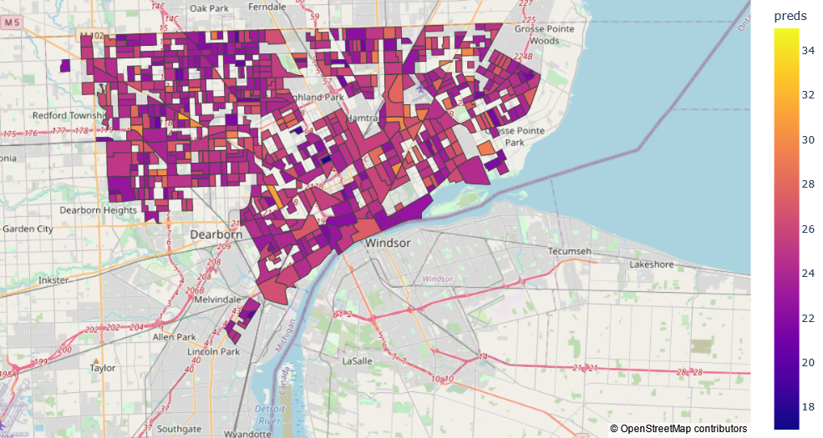
Visualization on validation dataset: Detroit
Actual score Predicted score
Notes:
Evelyn: We also did some visualization of the results, so we plotted the actual and predicted scores from the Detroit validation set, averaged by block group, and we displayed them on the map.
So on the left, we have the actual scores of block groups in Detroit, and on the right we have our predicted scores. Brighter colors correspond to higher levels of blight, while darker colors correspond to higher levels of upkeep. And even though the predictions for individual buildings are more noisy, if you look closely at both maps, you’ll notice that the predictions are similar to the average actual blight levels in each block group.

Slide 23
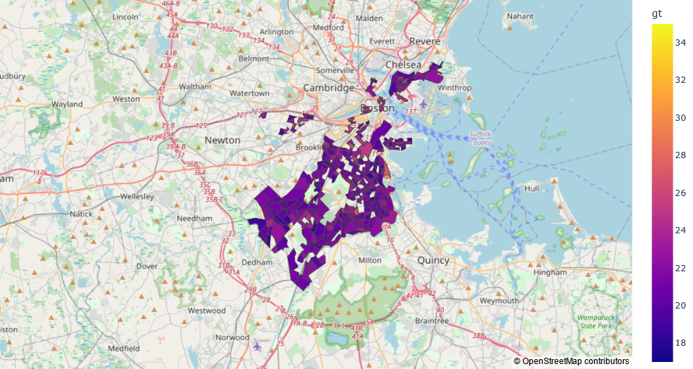

Visualization on validation dataset: Boston
Actual score Predicted score
Notes:
Evelyn: We also visualized scores from the Boston validation set by block group, and once again you can see that the actual and predicted scores are quite similar to one another.
Notice that the colors in Boston overall are a lot darker than in Detroit, indicating that Boston has a higher level of building upkeep than Detroit. This is in line with what we’ve observed in the past.

Slide 24
Inference on time series street view images
Inference
Notes:
So we’ve talked about training the neural network to predict upkeep levels for buildings in GSV images. Now, I’m going to talk about how we used the neural network to measure upkeep levels over time, in Boston.

Slide 25
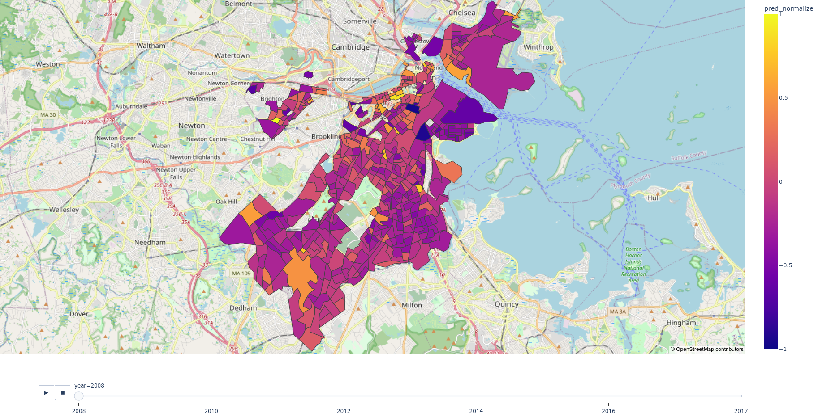
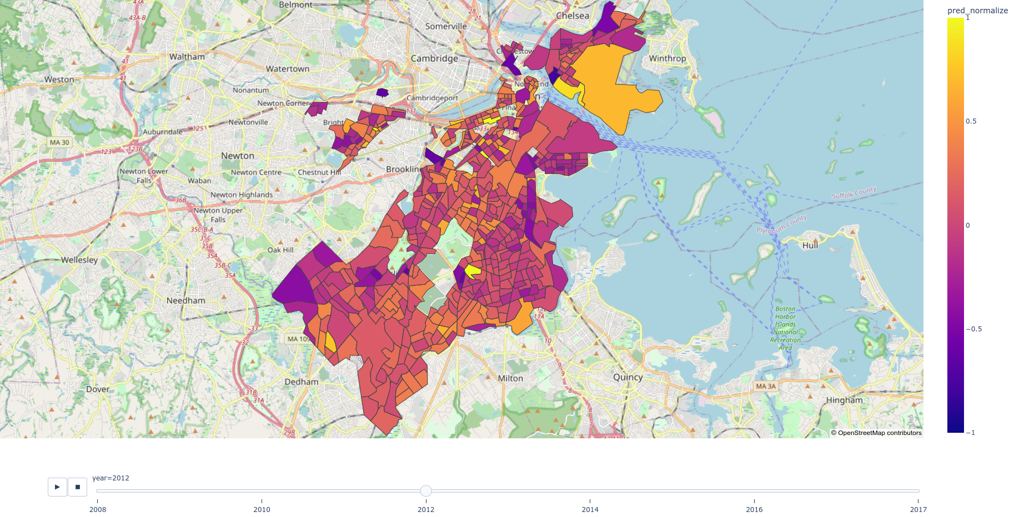
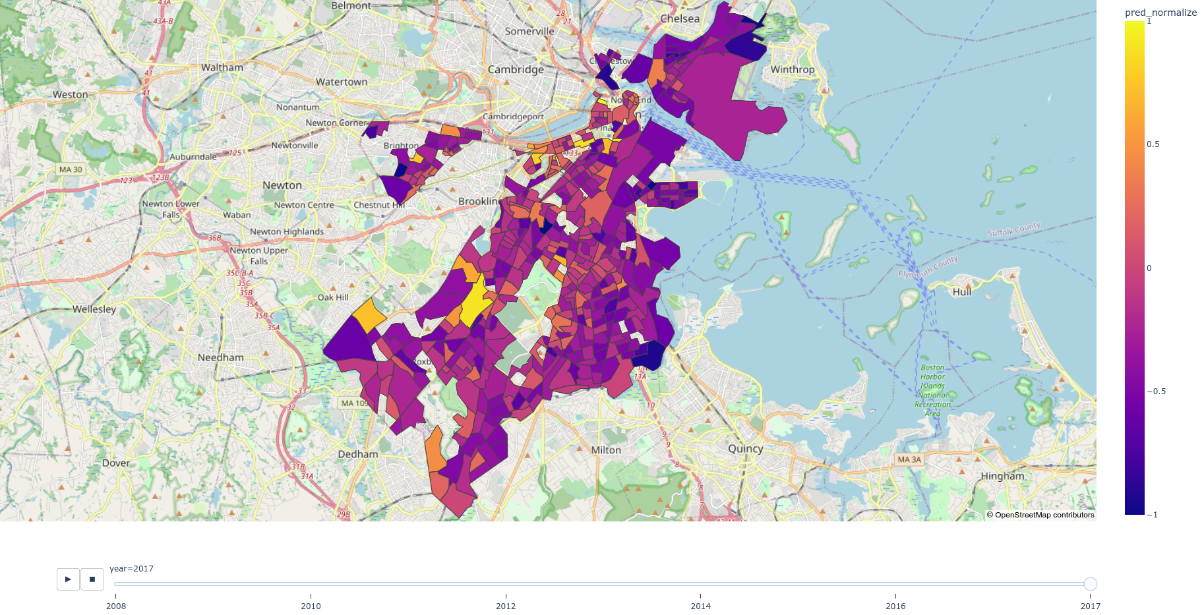
Time series analysis: Boston
2007-08
2011-12
2017
Notes:
We did time series analysis on GSV images taken between 2007 and 2017. Since there were far fewer images for even numbered years than for odd numbered years, we grouped consecutive years together - so 2007-08, etc. We took the avg of predicted TS scores for each block group during each 2 year period.
Going from left to right, most of the block groups shown in the maps get brighter between 2008 and 2011, and then darker between 2012 and 2017, indicating that the average level of blight in Boston has gone up and then down. Some block groups, like the one circled in green (click to show it), appear to have undergone an increase in blight between 2012 and 2017. However, we only have data for two buildings in this block group, so this trend is very uncertain.
So why did Boston become more blighted between 2008 and 2012?

Slide 26
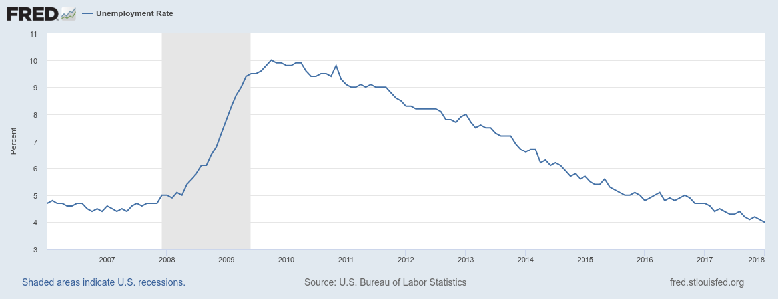
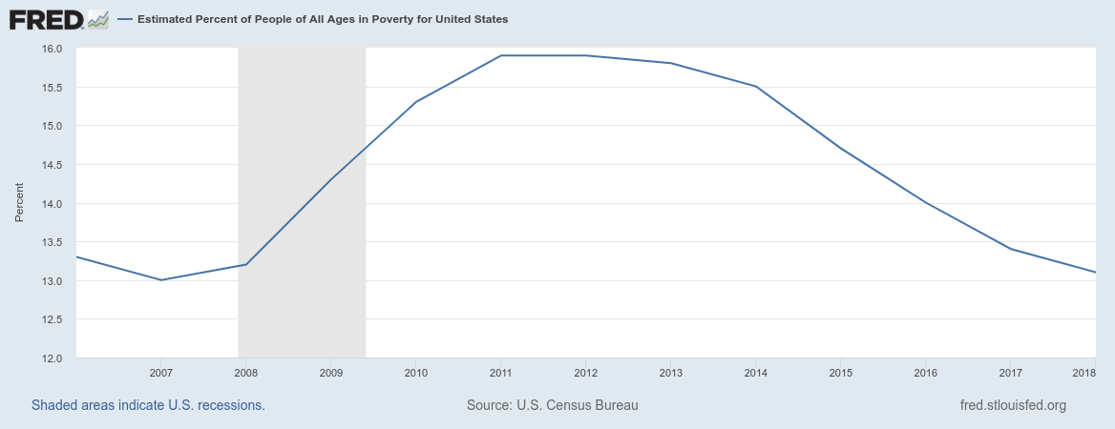
The Great Recession
Unemployment Rate
2007-09
Poverty Rate
Chang, S.-S; Stuckler, D; Yip, P; Gunnell, D (2013). "Impact of 2008 global economic crisis on suicide: Time trend study in 54 countries."
Notes:
Well, an important event in the global economy that occurred around this time was the Great Recession, which resulted in higher unemployment and poverty in the United States. The recession may have had a negative impact on well-being - for example, one study found that suicides increased in countries with higher levels of job loss.

Slide 27
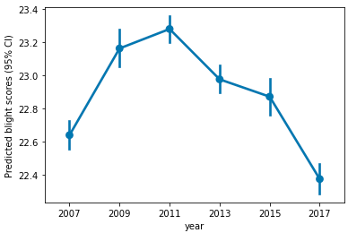
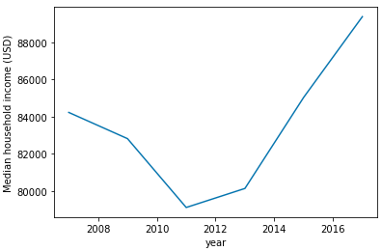
Well-being analysis: Boston
Predicted blight scores (95% CI)
Median household income in Boston
Notes:
So we decided to look at how the changes in urban blight in Boston over time might be related to the Great Recession, by seeing how the predicted TS scores for the time series data compare with median household income.
These error bars are 95% confidence intervals and they don’t overlap, so we can see that the changes in average blight scores in Boston over time are significant. And they’re associated with opposite changes in median household income (on the right) about 2 years later.

Slide 28
Conclusion
We trained a deep neural network to perform systematic social observation at scale.
Our neural network can identify changes in building upkeep in different neighborhoods and cities.
Our time series analysis shows how changes in building upkeep in Boston reflect the Great Recession and recovery.
Notes:
So to conclude, we trained a deep neural network to measure the level of upkeep in a neighborhood using Google Street View images of buildings. We call this technique systematic social observation at scale.
Our neural network can identify changes in average building upkeep at the block group level in different neighborhoods and cities.
And finally, our time series analysis shows how changes in building upkeep in Boston track overall economic trends, specifically the Great Recession and the subsequent recovery.

Slide 29
Expected impact
Understand how neighborhood upkeep in cities changes over time
Our other target cities: Austin, Detroit, Los Angeles, Philadelphia
Understand relationship between neighborhood upkeep and well-being
Measures of well-being: crime rates; physical, mental health; income; subjective well-being
Recommend policies to reduce inequities in well-being
e.g. targeted greening/cleaning initiatives
Notes:
In the future, we hope that our project will lead to a better understanding of how neighborhood upkeep in cities changes over time. Specifically, we hope to extend our time series analysis to other cities like Austin and Detroit.
We also hope to better understand the relationship between neighborhood upkeep and well-being using metrics such as crime rates, physical and mental health, income, and SWB.
And finally, we hope this research will lead to recommendations for policies that can reduce inequities in well-being. For example, we might recommend targeted greening and cleaning initiatives to reduce urban blight if we believe that they will lead to better community well-being.
Thank you all for listening, and we look forward to taking any questions you might have.

